Slide 1
Unit-6
Software Testing Techniques

Slide 2
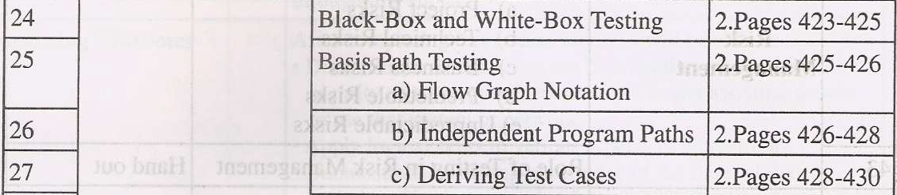
Topic to be covered

Slide 3
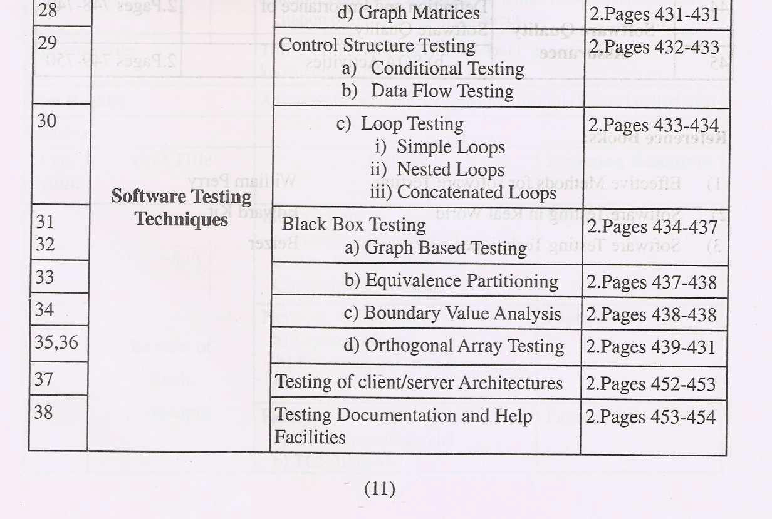
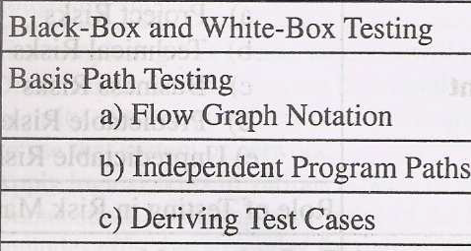
Topics to be covered

Slide 4
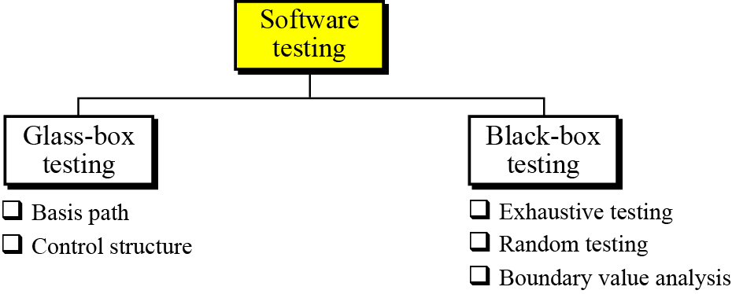
Software Testing Techniques
The goal of the testing phase is to find errors, which means that a good testing strategy is the one that finds most errors. There are two types of testing: glass-box and black-box (Figure 10.11).
Figure 10.11 Software testing

Slide 5
White Box Testing
Glass-box testing (or white-box testing) is based on knowing the internal structure of the software. The testing goal is to determine whether all components of the software do what they are designed for. Glass-box testing assumes that the tester knows everything about the software. In this case, the software is like a glass box in which everything inside the box is visible. Glass-box testing is done by the software engineer or a dedicated team.
Several testing methodologies have been designed in the past. We briefly discuss two of them: basis path testing and control structure testing.

Slide 6
What is Basis Path Testing?
Basis path testing was proposed by Tom McCabe. This method creates a set of test cases that executes every statement in the software at least once.
Basis path testing is a method in which each statement in the software is executed at least once.
Basis path testing, or structured testing, is a method for designing test cases intended to examine each mathematically possible path of execution at least once.

Slide 7
BASIS PATH TESTING EXAMPLE:VIDEO SALES
For the video sales and rental shop example, consider the following
procedure for reserving a copy of a movie video.
Procedure: reserveVideoCopy return(result)
1. If (status = “available”) OR ((status = “rented”) AND (returnDate ≤
requestDate))
2. status = “reserved”
3. link video copy instance to member instance
4. result = “success”
5. Else
6. result = “failure”
7. Endif
End
Draw the flow graph for the reserveVideoCopy procedure. Show the flow graph node to program statement mapping and clearly label the regions of the flow graph.

Slide 8
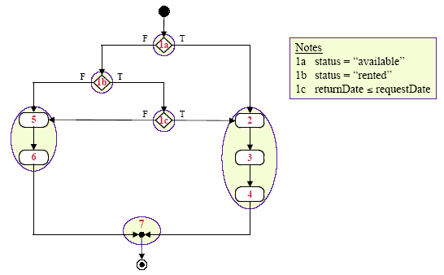
BASIS PATH TESTING EXAMPLE: ACTIVITY DIAGRAM

Slide 9
Independent path
An independent path is any path through the software that introduces at Path least one new set of processing statements or a new condition. When stated in terms of a flow graph, an independent path must move along at least one edge that has not been traversed before the path is defined.[Pressman-01]

Slide 10

What is a Basis Path?
A basis path is a unique path through the software where no iterations are allowed - all possible paths through the system are linear combinations of them.

Slide 11
McCabe’s Basis Path Testing
Steps:
1: Draw a control flow graph
2: Calculate Cyclomatic complexity
3: Choose a “basis set” of paths
4: Generate test cases to exercise each path

Slide 12
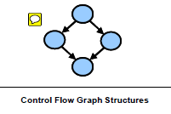
Step 1: Draw a Control Flow Graph
The Control Flow Graph:-Any procedural design can be translated into a control flow graph:
Lines (or arrows) called edges represent flow of control
Circles called nodes represent one or more actions
Areas bounded by edges and nodes called regions
A predicate node is a node containing a condition

Slide 13
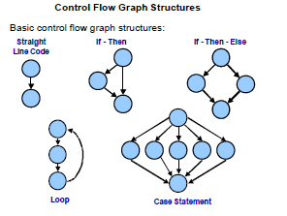
Basic Control Flow Graph Structures

Slide 14
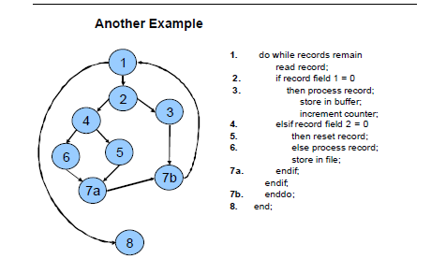
Step 1: Draw a Control Flow Graph (cont.)

Slide 15
Step 2: Calculate Cyclomatic Complexity
McCabe’s Cyclomatic Complexity is a measure of the number of linearly independent paths through the unit/component.
It can therefore be used in structural testing to determine the minimum number of tests that must be executed for complete basis path coverage.

Slide 16
Step 2: Calculate Cyclomatic Complexity (contd…)
Cyclomatic Complexity is calculated from a control flow graph by
subtracting the number of nodes from the number of edges and adding 2 times the number of unconnected parts of the graph.
straight-line code (first control flow graph above) has 1 edge and 2 nodes so its complexity is 1-2+2*1 = 1.
This second graph has 4 edges and 4 nodes so its complexity is 4-4+2*1 = 2.

Slide 17
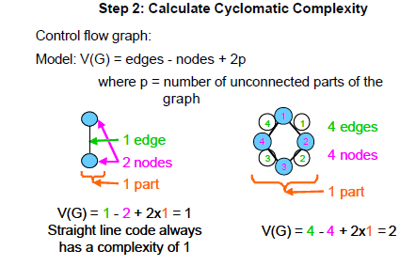
Step 2: Calculate Cyclomatic Complexity (contd…)

Slide 18
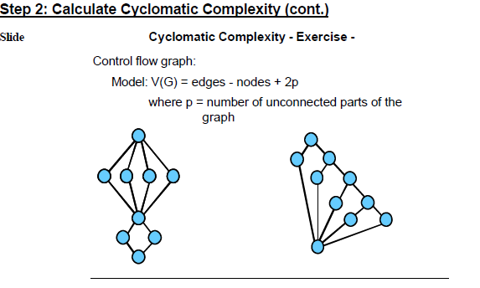
Step 2: Calculate Cyclomatic Complexity (contd…)

Slide 19
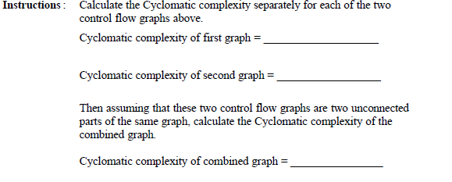
Step 2: Calculate Cyclomatic Complexity (contd…)

Slide 20
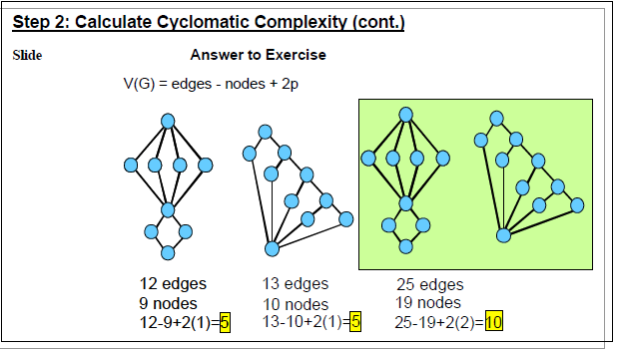
Step 2: Calculate Cyclomatic Complexity (contd…)

Slide 21
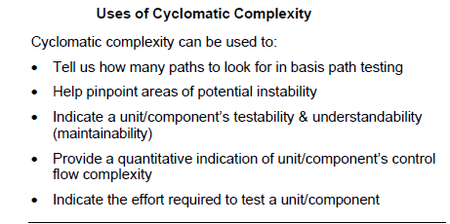
Step 2: Calculate Cyclomatic Complexity (contd…)

Slide 22
Use of Cyclomatic Complexity
Based on the unit/component’s Cyclomatic complexity we can apply appropriate levels of effort on detailed inspections and testing.
Those units/components having a high complexity measure need more intense inspection and test, those with lower measures are likely to have fewer defects and thus would require less stringent inspection and test.
The Cyclomatic complexity also tells us how many paths to evaluate for basis path testing

Slide 23
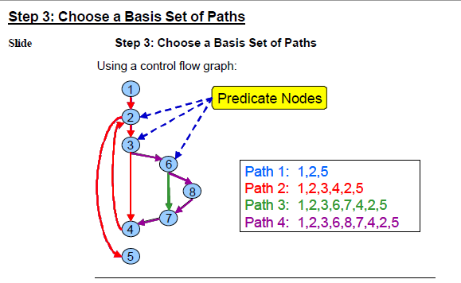
Step 3: choose a basis set of paths

Slide 24
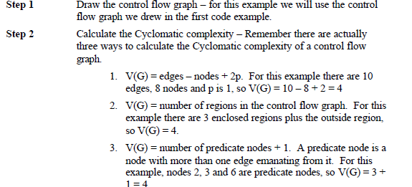
Step 3: choose a basis set of paths( Contd…).

Slide 25
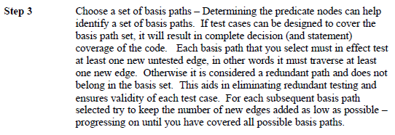
Step 3: choose a basis set of paths( Contd…)

Slide 26
Step 3: choose a basis set of paths( Contd…)

Slide 27
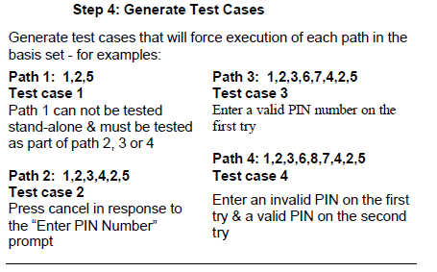
Step 4: Generate Test Cases

Slide 28
Control structure testing
Control structure testing is more comprehensive than basis path testing and includes it. This method uses different categories of tests that are listed below.
Condition testing
Data flow testing
Loop testing

Slide 29
1 Condition Testing
Condition testing is a test construction method that focuses on exercising the logical conditions in a program module. Errors in conditions can be due to:
Boolean operator error
Boolean variable error
Boolean parenthesis error
Relational operator error
Arithmetic expression error

Slide 30
1 Condition Testing(contd….)
definition: "For a compound condition C, the true and false branches of C and every simple condition in C need to be executed at least once.“
Multiple-condition testing requires that all true-false combinations of simple conditions be exercised at least once. Therefore, all statements, branches, and conditions are necessarily covered.

Slide 31
2 Data Flow Testing
Selects test paths according to the location of definitions and use of variables. This is a somewhat sophisticated technique and is not practical for extensive use. Its use should be targeted to modules with nested if and loop statements.

Slide 32
3. Loop Testing
Loops are fundamental to many algorithms and need thorough testing. There are four different classes of loops:
simple
nested,
concatenated,
unstructured.

Slide 33
1.Simple Loops
Simple Loops, where n is the maximum number of allowable passes through the loop. Skip loop entirely
Only one pass through loop
Two passes through loop
m passes through loop where m<n.
(n-1), n, and (n+1) passes through the loop.

Slide 34
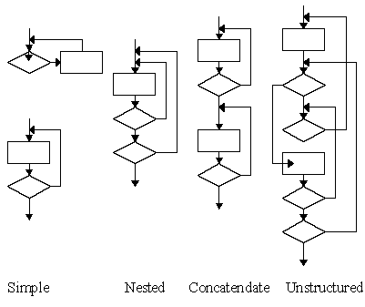
1.Simple Loops

Slide 35
2.Nested Loops
Start with inner loop. Set all other loops to minimum values.
Conduct simple loop testing on inner loop.
Work outwards
Continue until all loops tested.

Slide 36
2.Nested Loops

Slide 37
3.Concatenated Loops
If independent loops, use simple loop testing.
If dependent, treat as nested loops.

Slide 38
4.Unstructured loops
Don't test - redesign.

Slide 39
Black-box testing
Black box testing gets its name from the concept of testing software without knowing what is inside it and without knowing how it works. In other words, the software is like a black box into which the tester cannot see. Black-box testing tests the functionality of the software in terms of what the software is supposed to accomplish, such as its inputs and outputs. Several methods are used in black-box testing, discussed below.

Slide 40
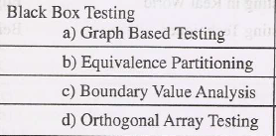
Black Box Testing Testing Techniques

Slide 41
Equivalence Class Partitioning
Equivalence class testing is based upon the assumption that a program’s input and output domains can be partitioned into a finite number of (valid and invalid) classes such that all cases in a single partition exercise the same functionality or exhibit the same behavior .
The partitioning is done such that the program behaves in a similar way to every input value belonging to an equivalence class.
Test cases are designed to test the input or output domain partitions. Equivalence class is determined by examining and analyzing the input data range.

Slide 42
Equivalence Class Partitioning
Only one test case from each partition is required, which reduces the number of test cases necessary to achieve functional coverage .
The success of this approach depends upon the tester being able to identify partitions of the input and output spaces for which, in reality, cause distinct sequences of program source code to be executed.

Slide 43
Steps to create Test Cases
The Steps for creating test cases are as follows
A. define the equivalence classes .
B. Write the initial test case that cover as many as valid equivalence classes as possible.
C. Continue writing test cases until all of the valid equivalence classes have been included.
D. finally write one test case for each invalid class.

Slide 44
Equivalence Class Partitioning- Advantages:
It eradicates the need for exhaustive testing, which is not feasible.
One of the advantages of equivalence class portioning is; it enables a tester to cover a large
domain of inputs or outputs with a smaller subset selected from an equivalence class.
It allows a tester to select a subset of test inputs with a high chance of identifying a defect.

Slide 45
Equivalence Class Partitioning- Limitations:
a. One of the limitations of this technique is that it makes the assumption that the data in the same equivalence class is processed in the same way be the system .
b. Equivalence partitioning is not a stand-alone method to determine test case. It has to be supplemented by boundary value analysis .

Slide 46
Orthogonal Arrays
Orthogonal Array Testing Strategy (OATS) is a systematical, statistical way of testing pair-wise interactions by deriving suitable small set of test cases from a large number of scenarios.
The testing strategy can be used to reduce the number of test combinations and provide maximum coverage with a minimum number of test cases.
OATS utilizes an array of values representing variable factors that are combined pair-wise rather than representing all combinations of factors and levels.

Slide 47
Example fororthogonal array testing strategies
Here we have considered 3 parameters named as – A, B, and C and it has positive values as 1, 2 and 3.Testing all combinations of the 3 parameters would involve executing a total of 27 test cases. Generally while programming works start a fault will mostly occurs for two parameters, not for three. In this case the fault may occur for each of the 3 test cases as: A=1, B=1, C=1, A=1, B=1, C=2, and A=1, B=1, C=3. The usefully of OATS is no need to run all the 27 test cases, only 9 test cases are enough to test. The 9 scenarios outlined in Table5 (on the next screen) address all possible pairs within the three parameters.

Slide 48
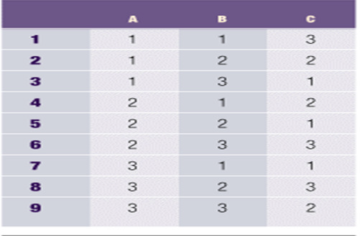
Pair-wise Combination of Parameters- Sample array

Slide 49
Pair-wise Combination of Parameters- Sample array
All possible pair wise combinations between parameters A and B, B and C, and C and A are displayed in Table 5 here nine scenarios provide the same coverage as executing all 27 scenarios. This same concept is applied to more complex scenarios where testing an application might require 10,000+ test cases and utilizing OATS, it can be reduced significantly in the number of test scenarios, such as down to 1,000 or less test cases to execute

Slide 50
Further links
http://elearning.tvm.tcs.co.in/td_flash/TD_flash_sc3.swf
http://www.onestoptesting.com/equivalence-partitioning/

Slide 51
Boundary-value testing
Errors often happen when boundary values are encountered. For example, if a module defines that one of its inputs must be greater than or equal to 100, it is very important that module be tested for the boundary value 100. If the module fails at this boundary value, it is possible that some condition in the module’s code such as x ≥ 100 is written as x > 100.

Slide 52

10-6 DOCUMENTATION
For software to be used properly and maintained efficiently, documentation is needed. Usually, three separate sets of documentation are prepared for software: user documentation, system documentation and technical documentation.
i
Documentation is an ongoing process.

Slide 53
User documentation
To run the software system properly, the users need documentation, traditionally called a user guide, that shows how to use the software step by step. User guides usually contains a tutorial section to guide the user through each feature of the software.
A good user guide can be a very powerful marketing tool: the importance of user documentation in marketing cannot be over-emphasized. User guides should be written for both the novice and the expert users, and a software system with good user documentation will definitely increase sales.

Slide 54
System documentation
System documentation defines the software itself. It should be written so that the software can be maintained and modified by people other than the original developers. System documentation should exist for all four phases of system development.

Slide 55
Technical documentation
Technical documentation describes the installation and the servicing of the software system. Installation documentation defines how the software should be installed on each computer, for example, servers and clients. Service documentation defines how the system should be maintained and updated if necessary.

